Slide 1
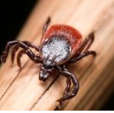
TICK BORNE DISEASES IN NOVA SCOTIA
Prepared by Donna Lugar
902-835-5643
donna.lugar@ns.sympatico.ca

Slide 2
TICKS
There are apparently at least 16 different kinds of ticks that have been found in Nova Scotia, but only two types frequently bite people: dog (wood) ticks and blacklegged (deer) ticks. Lone Star ticks, that also bite people, have been found sporadically throughout the province.
Blacklegged ticks are very small (smaller than dog ticks), and their looks change during their life cycle and when feeding.

Slide 3
BLACK-LEGGED TICK

Slide 4
BLACKLEGGED vs DOG TICKS

Slide 5
WHAT IS LYME DISEASE?
Lyme disease is a serious illness caused by the bite of a tick infected with the bacterium Borrelia burgdorferi.
Lyme disease is the most common tick borne disease in Canada (well, at least the best known one!).

Slide 6
OTHER TICK BORNE DISEASES IN NOVA SCOTIA
Human Granulocytic Anaplasmosis (HGA)
Babesia spp
Borrelia miyamotoi
Powassan virus
Bartonella spp. (dog ticks & blacklegged ticks)
Rickettsia spp. (dog ticks & blacklegged ticks)
Francisella tularensis (dog ticks & blacklegged ticks)
Anaplasma phagocytophilum (dog ticks)
Due to migratory birds, ticks can be carrying other illnesses as well.
New tick borne diseases are being discovered on a regular basis.

Slide 7
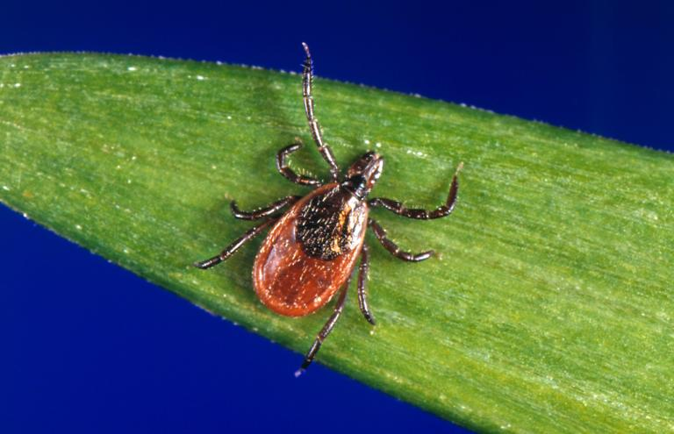
WHERE ARE TICKS FOUND?
Blacklegged ticks have now been found throughout the province
You DO NOT have to be in an endemic area to be bitten by a disease carrying tick!
Areas have different levels of concentration.

Slide 8
LYME DISEASE ESTIMATED RISK AREAS

Slide 9
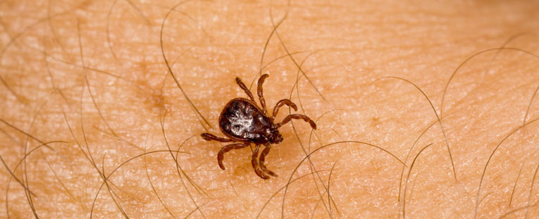
WHEN ARE TICKS ACTIVE
Ticks can be active all year (when temperature around 4°C)
Adult blacklegged ticks are most active in the spring and fall.
Larvae and nymphs are most active in the spring and summer.

Slide 10
PREVENTION
Know where ticks can be found (almost anywhere).
Frequently brush yourself off while outdoors, including hair/head.
Shower soon after being outdoors and perform a thorough tick check.

Slide 11
PREVENTION con’t
Reduce ticks in your yard through landscaping.
Consider permethrin treated clothes if spending a lot of time outdoors.
Know how to properly remove a tick.

Slide 12
HOW TO REMOVE A TICK

Slide 13
PERMETHRIN TREATED CLOTHING
On June 19, 2017, “No Fly Zone” Permethrin treated clothing was registered and approved for sale in Canada.
Select Mark’s stores carry a small selection. You can also purchase via their website.

Slide 14
TRANSMISSION TIME FOR DISEASE
A research article entitled “Lyme borreliosis: a review of data on transmission time after tick attachment” states:
“LB (Lyme borreliosis) infection can never be excluded after a tick bite irrespective of the estimated duration of attachment time.”
Some co-infections, such as Powassan virus, can apparently be transmitted in as little as 15 minutes.

Slide 15
CONFIRMED/PROBABLE CASES
In 2017, there were 586 cases.
In 2016, there were 326 cases
In 2015, there were 254
From 2002-2015, there were 769 cases
The Case Definition is quite rigid; therefore, the true numbers are undoubtedly much higher.

Slide 16
HOW TO DIAGNOSE
A Lyme disease diagnosis should be CLINICAL – based upon symptoms and physical findings
Serologic tests have sensitivity and specificity limitations - http://www.hc-sc.gc.ca/dhp-mps/medeff/bulletin/carn-bcei_v22n4-eng.php#a1
A recent research document suggests that a considerable number of cases are being missed – “Under-detection of Lyme disease in Canada” –https://www.mdpi.com/2227-9032/6/4/125/htm.

Slide 17
LYME RASHES
Although the “bull’s-eye” rash is considered classic, other erythema migrans (EM) rashes are seen far more commonly. Only 20-30% (if that) of rashes are the bull’s-eye.
The “bull’s-eye” rash requires no further verification prior to starting an appropriate course of antibiotic therapy.

Slide 18
The Bull’s-Eye Rash

Slide 19
Other Potential Rashes…
There are several different types of rashes that are possible – http://www.cdc.gov/lyme/signs_symptoms/rashes/html
Some do not get (or see) any rash!
Other tick borne diseases can cause different rashes.
Notes:
There are several different types of rash that are possible. Some do not get (or see) any rash!
http://www.cdc.gov/lyme/signs_symptoms/rashes.html

Slide 20
SYMPTOMS
Symptoms can vary from person to person and can also depend upon what additional tick borne viruses/illnesses were transmitted.
Fever, chills, headache, fatigue, muscle and joint aches, and swollen lymph nodes are some of the possible early symptoms
Possibly an Erythema migrans (EM) rash, which expands over time

Slide 21
SYMPTOMS con’t
If not caught right away, symptoms can increase and could possibly include:
Severe headaches and neck stiffness
Additional EM rashes on other areas of the body
Arthritis with severe joint pain and swelling, particularly the knees and other large joints
Facial palsy

Slide 22
SYMPTOMS con’t
Intermittent pain in tendons, muscles, joints, and bones
Heart palpitations or an irregular heart beat (Lyme carditis)
Episodes of dizziness or shortness of breath
Inflammation of the brain and spinal cord
Nerve pain
Shooting pain, numbness, or tingling in the hands or feet
Problems with short-term memory

Slide 23
TREATMENT
If caught early, and no co-infections are present, most cases of Lyme disease can be treated successfully with a few weeks of antibiotics.
If not caught early, or if other tick borne diseases/viruses were transmitted, a different treatment protocol may be required.

Slide 24
TREATMENT con’t
The N.S. Statement for Managing Lyme Disease follows the IDSA guidelines.
Lyme Literate Doctors generally follow guidelines prepared by ILADS.
At present, both sets of guidelines are noted on the federal government website regarding Lyme disease.

Slide 25
TREATMENT con’t
ALL patients seem to respond differently to treatment as there are so many variables.

Slide 26
IDSA Lyme Guidelines
“It is important to realize that guidelines cannot always account for individual variation among patients. They are not intended to supplant physician judgment with respect to particular patients or special clinical situation. IDSA considers adherence to the guidelines listed below to be voluntary, with the ultimate determination regarding their application to be made by the physician in the light of each patient’s individual circumstances”

Slide 27
POSSIBLE MISDIAGNOSIS
Lyme can commonly be misdiagnosed as other illnesses such as:
Chronic Fatigue Syndrome
Fibromyalgia
MS
Lupus
Rheumatoid Arthritis
And many, many more

Slide 28
Excerpt from “Conquering Lyme Disease”
“Flu-like symptoms in the absence of cough, runny nose, vomiting or diarrhea should also raise suspicion for possible Lyme disease.”

Slide 29
Excerpt from “Conquering Lyme Disease”
“For many of those whose infection is caught early, Lyme disease is a mild to moderate illness that resolves with antibiotic treatment. For others, it is a painful, disturbing, and prolonged illness – disabling, frightening, confusing, isolating, and sometimes life-altering.”

Slide 30
Excerpt from “Conquering Lyme Disease”
“Health care providers may not be aware of the diverse manifestations of Lyme disease, the limitations of existing diagnostic tests, the sophisticated survival strategies for immune evasion of the organism that causes Lyme disease (the bacterium Borrelia burgdorferi), and the complex challenges posed by patients with persistent symptoms. This is not a simple disease that can be easily dismissed.”

Slide 31
Excerpt from “Conquering Lyme Disease”
“The name of the rash, ‘erythema,’ is from Ancient Greek ‘to redden, to turn red.’ If untreated, the rash expands gradually over the next several weeks. As it grows, it may develop a central clearing or a ‘bull’s eye’ appearance. However, in most cases, the rash will be uniformly red. Alternatively, the rash may have a darker bluish-red center, a raised or blistery central region, or another atypical appearance. The shape of the rash varies from circular to oblong, oval, linear, or even triangular. Even though many patients and physicians would recognize a typical bull’s eye rash as a marker of likely Lyme disease, only about 20 to 30 percent of Lyme rashes will have this classic bull’s eye presentation. A diameter of two inches or more is seen in the majority of Lyme rashes.”

Slide 32
Excerpt from “Conquering Lyme Disease”
“Lyme disease has been documented to cause impairments in memory, word finding, fine motor control, language conceptual ability, and motor functioning. The most consistently identified deficits in adults with Lyme disease have been problems with verbal memory, verbal fluency, and mental processing speed. Patients often refer to their cognitive limitations as “brain fog.” Studies by various reseaches(sic) (Keilp et al. 2006; Kaplan and Jones-Woodward 1997; Elkins et al. 1999) support the conclusion that cognitive impairments are not secondary to a psychological response to chronic illness due to a mood disorder.”

Slide 33
Excerpt from “Conquering Lyme Disease”
“In summary, the narrow clinical criteria for surveillance that are important and necessary to objectively monitor disease incidence over time are not comprehensive enough to encompass all manifestations of this illness. Unfortunately, this surveillance case definition has caused confusion and controversy among physicians and patients regarding who should be diagnosed with and treated for Lyme disease.”

Slide 34
CONCLUSION
Ticks carrying disease have been in the province a long time!
Symptoms can mimic MANY other illnesses such as early ALS, early Alzheimers, MS, Juvenile Arthritis, Rheumatoid Arthritis, Fibromyalgia, ME/CFS, etc.
Untreated Lyme can spread to the brain, heart, and joints.

Slide 35
CONCLUSION con’t
Disease carrying ticks can now be found throughout Nova Scotia.
Testing is not 100% accurate. A negative ELISA does not necessarily mean you do not have Lyme! There are many reasons for a negative test!
If not caught early, the “CDC/IDSA approved” treatment generally does not work to eradicate all symptoms.

Slide 36
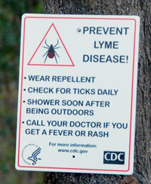
CONCLUSION con’t
ALWAYS take precautions when spending time outdoors!
Make tick checks a regular part of your daily routine!
Make yourself knowledgeable!

Slide 37
REFERENCES
Canadian Adverse Reaction Newsletter, Volume 22, Issue 4, October 2012 - http://www.hc-sc.gc.ca/dhp-mps/alt_formats/pdf/medeff/bulletin/carn-bcei_v22n4-eng.pdf
Symptoms of Tickborne Illness – CDC - https://www.cdc.gov/ticks/symptoms.html
Signs and Symptoms of Untreated Lyme Disease – CDC - https://www.cdc.gov/lyme/signs_symptoms/index.html
University of Rhode Island, TickEncounter Resource Center - http://www.tickencounter.org/

Slide 38
REFERENCES con’t
Nova Scotia’s Tick Borne Diseases Response Plan - https://novascotia.ca/dhw/cdpc/documents/Tick-Borne-Disease-Response-Plan.pdf
Statement for Managing Lyme in Nova Scotia - https://novascotia.ca/dhw/CDPC/documents/statement_for_managing_LD.pdf
NS Department of Health & Wellness, Communicable Disease Prevention and Control, Lyme Disease - https://novascotia.ca/dhw/CDPC/lyme.asp

Slide 39
REFERENCES con’t
Government of Canada, Lyme Disease - https://www.canada.ca/en/public-health/services/diseases/lyme-disease.html
Canadian Lyme Disease Foundation (CanLyme) - https://canlyme.com/
Government of Canada, For Health Professionals: Lyme disease - https://www.canada.ca/en/public-health/services/diseases/lyme-disease/health-professionals-lyme-disease.html
Lyme disease Case Definition - https://novascotia.ca/dhw/populationhealth/surveillanceguidelines/lyme.pdf

Slide 40
REFERENCES con’t
Health Canada, Consumer Product Safety, “NO FLY ZONE” - http://pr-rp.hc-sc.gc.ca/1_1/view_label?p_ukid=95516898
Health Canada, Product Information - http://pr-rp.hc-sc.gc.ca/ls-re/lbl_detail-eng.php?p_disp_regn=%2732757%27&p_regnum=32757
“Conquering Lyme Disease” by Drs. Fallon & Sotsky of the Columbia University Medical Centre.
“Under-Detection of Lyme Disease in Canada” - https://www.mdpi.com/2227-9032/6/4/125/htm

Slide 41
ADDITIONAL AREAS FOR INFO
Facebook - https://www.facebook.com/Lyme-Disease-in-Nova-Scotia-the-Atlantic-Provinces-217895438247422/
My blog - https://shiningthelymelight.com/2017/07/12/lyme-disease-resourcesinformation-nova-scotia-the-atlantic-provinces/
My Scoop.it pages - https://www.scoop.it/t/tick-borne-diseases-in-canada and https://www.scoop.it/t/lyme-disease-other-tick-borne-diseases

